Slide 1



Day 27
contact@anubhavtrainings.com
ABAP RESTFUL APPLICATION PROGRAMMING

Slide 2

Agenda – Day 27
Local Types/Classes in ABAP with Global Classes
Implementing Class Pool Concept
Behavior Definition Introduction
Create Behavior Definition
Create Behavior implementation for Unmanaged Scenario
Implementing Create, Update and Delete
Make field read only
Making field Mandatory
Add validation to the code
Implement Actions - set_status_booked

Slide 3
Local Types/Classes in ABAP with Global Classes
Local Types for Global Classes - Within class pools, as in virtually any other ABAP program, data types, local interfaces, and local classes can be defined to ensure a better structure of the implementation of the global class.
More number of classes will cause confusion and over-modularization increase the complexity of our design
More number of global classes, will increase the chance of our code being exposed to reports/classes which we may want to use only a private
Allow a modularized way of designing app but still keeping our code in a single contain, a good balance between number of classes v.s modularization.
At times we need so many classes for different purpose with very limited no of methods. 2 meh. + 20 classes, Create a class pool would be a good options.

Slide 4
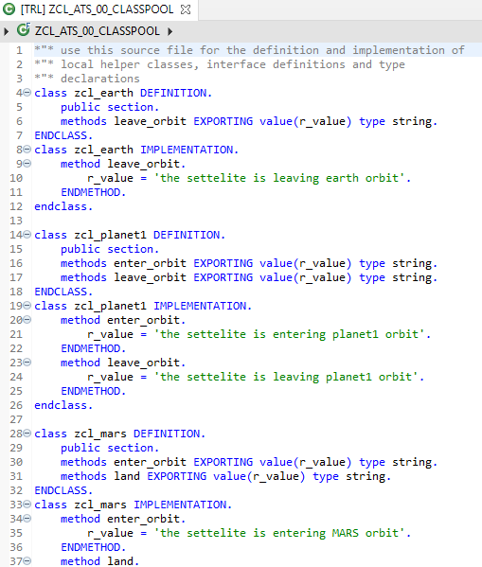
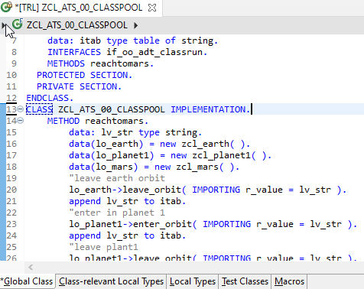
Implementing Class Pool Concept
Global Class
Exercise
Class Pool Code
Local Types/Class

Slide 5
Behavior Definition
A Business Object BDEF is an ABAP Repository object (just like Tables, classes, FM, Programs).
This BDEF determines the behavior of an BO in context of RESTful ABAP programming. In simple words, what are all the different operations our BO can do like create, update, delete..
This is created using BDL (Behavior definition Language)) and comprises modeling capability aspect of BP node for e.g. CRUD, actions, local between parent child etc.
A BDEF always refers to a CDS Model. This reference results from the name equality with root entity,
Your CDS view name = BDEF Name
CDS View (root)
Business Object
Behavior Definition
Code is written in behavior pool, pool of local classes inside a global class
1 0..1
1
1
1..N
0..N
CDS Childs
Behavior Implementation
(M- option, U- Mandatory)

Slide 6
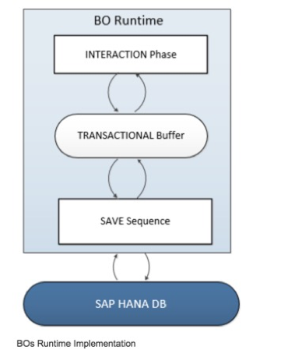
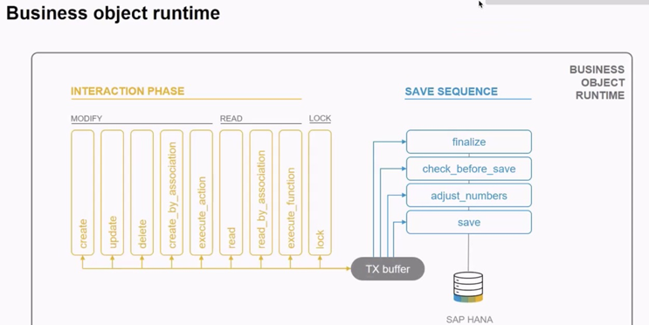
Business Object’s Runtime Implementation
The business object runtime mainly consists of two parts: The first part is the interaction phase where a consumer calls the business object operations to change data and read instances with or without the transactional changes. The business object runtime keeps the changes in its internal transactional buffer which represents the state of the instance data. This transactional buffer is always required for a business object. After all changes were performed, the data can be persisted. This is realized with the save sequence.

Slide 7
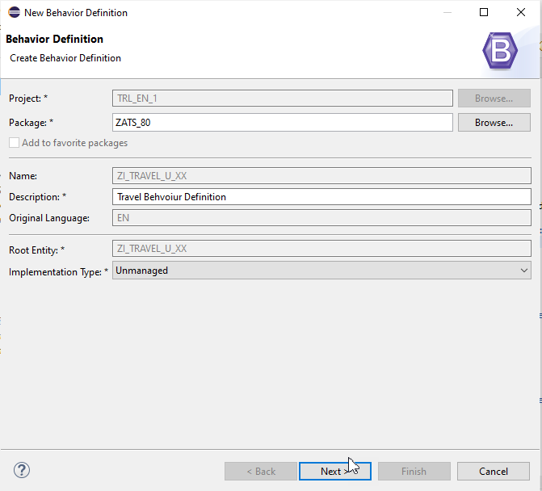
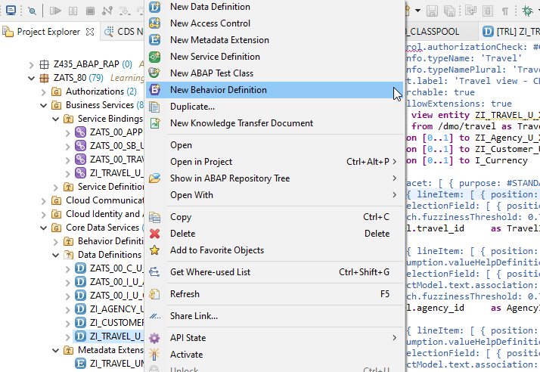
Create of Behaviour Definition

Slide 8
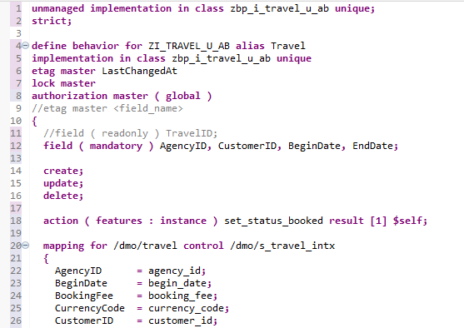
Implementing Behaviour Definition
Exercise
Behaviour Definition Code

Slide 9
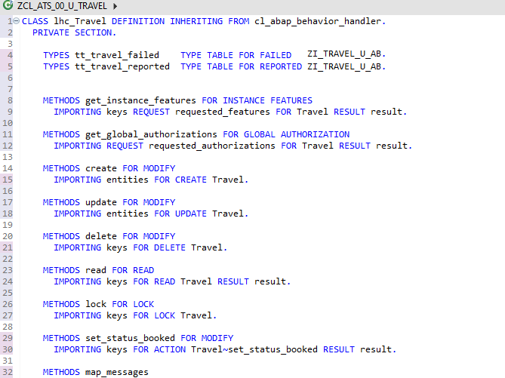
Behaviour Pool Logic
Exercise
Behaviour Pool Logic

Slide 10

End of Day 27
Trainer: Anubhav Oberoy

Slide 11
Trainer: Anubhav Oberoy

Slide 12
THANK YOU
If you cannot do
great things, do small things in a great way.
Anubhav Oberoy
https://www.anubhavtrainings.com

Slide 13


We’re committed to empower you to be
Most Desirable Resource
through powerful training solutions.
We build the workforce of the future.
250+
Corporate Clients
30,000+
Learners Trained
25000+
Learners Placed
FREE WEBINARS
Sign up for free webinars with industry experts every fortnight!
Enroll Now!
Contact us today!
https://anubhavtrainings.com/

Slide 14




More from AnubhavTrainings.com

